Slide 1





Words
f
Heart

Slide 2
Today isn't just any day to be skipped , it's the day I was gifted with a friend who lights up me without even realizing it.
You’re Chosen family , The keeper of my secrets , Healer of the pain , Theodore and A partner in laughter and chaos. Not by the blood , but by heart. A bond unbreakable in the storms, never apart . Even if I had millions of reasons to fight, I will always have one reason to come back.
Few Words for You

Slide 3
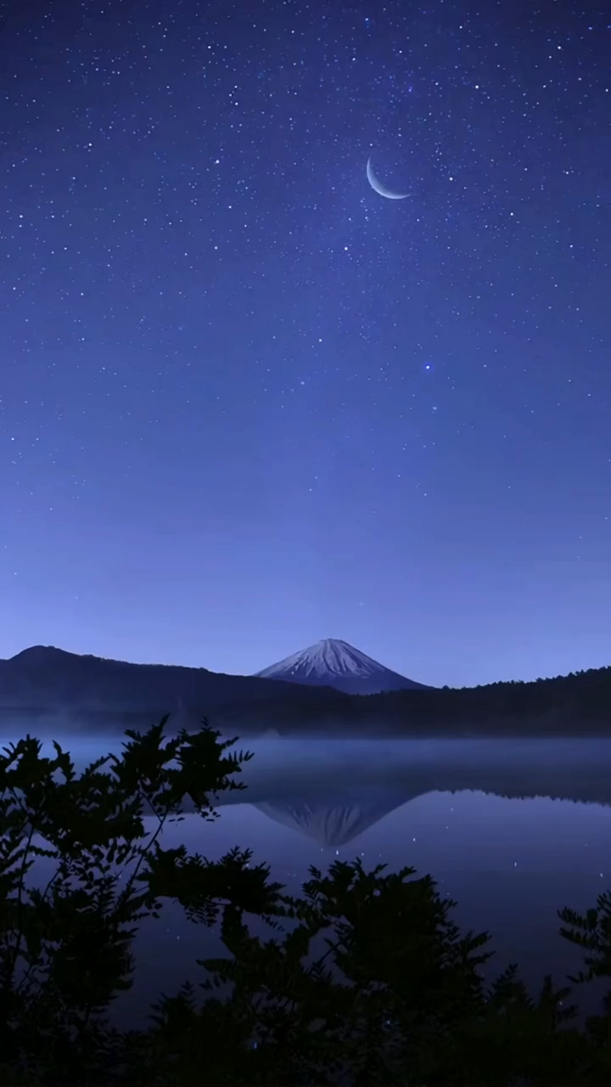
There is a light in your soul which is far superior than the darkness of this entire world , you may not realize it but I know because those are the lights guided me through my darkest days, Leading a path and pushed forward when I thought I could go on.
So embrace that glimmer of hope and embrace yourself.

Slide 4
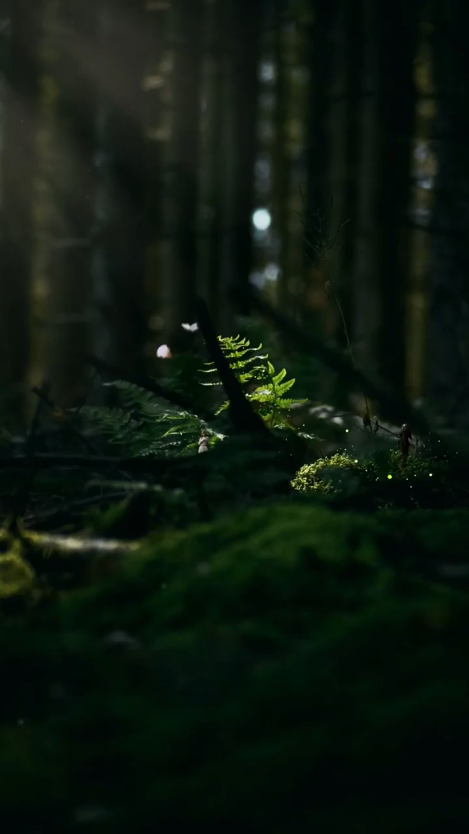
You're my smile in my saddest days. To the one I run when my life gets messy, thank you for being my listener even you had much and being patient with me.

Slide 5
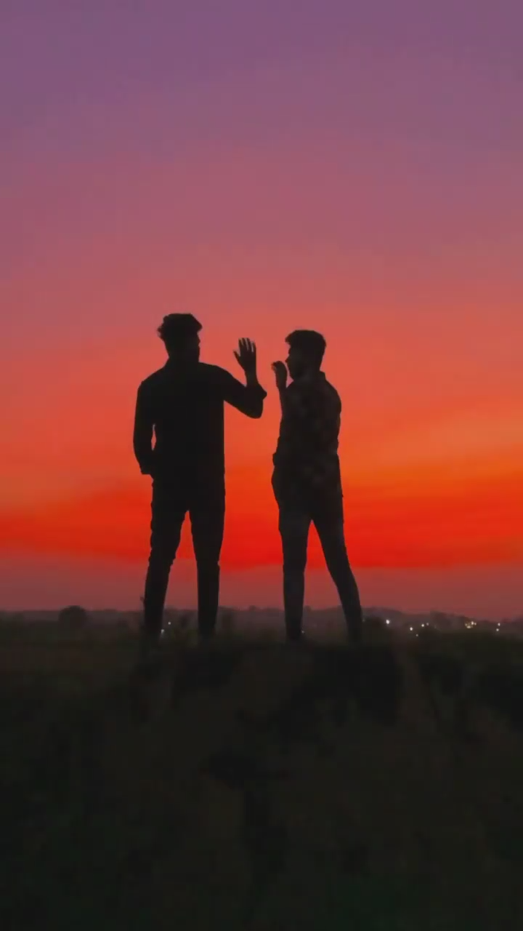
Spending little time with you feels like a sudden reminder that life is still beautiful and worth living. Life isn't beautiful it is made beautiful by someone like you. Even if I had a thousand other friends, still no one could be you.

Slide 6
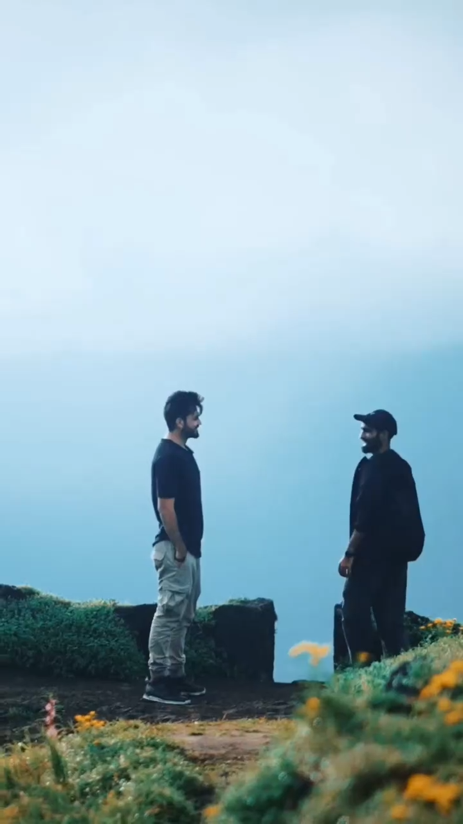
Words aren’t enough. Heart isn’t enough.
But okka matalo cheppali ante
E jivithaniki Ee person chalu anipinche person ra nuvvu.

Slide 7
Once again Happy Birthday SUSHANTH
always keep shining and

